Slide 1


Ireland
CULTURE SPOT

Slide 2
Solve the riddle.
Am I a part of Great Britain?
The answer to that question is: only in the North
My capital is called Dublin
And I have a leprechaun holding gold.
The answer is: IRELAND
Take a virtual trip to Ireland.

Slide 3
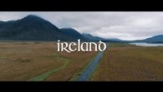

Slide 4
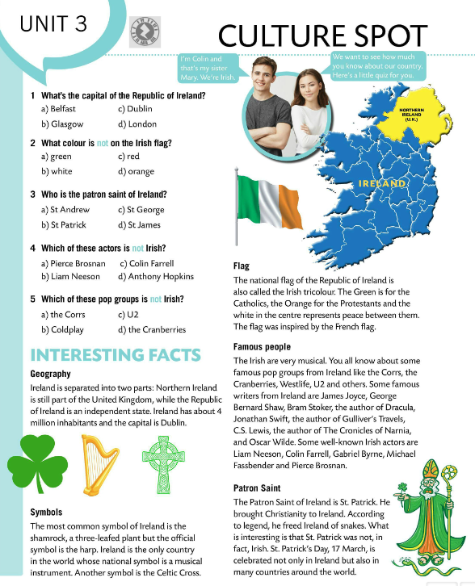
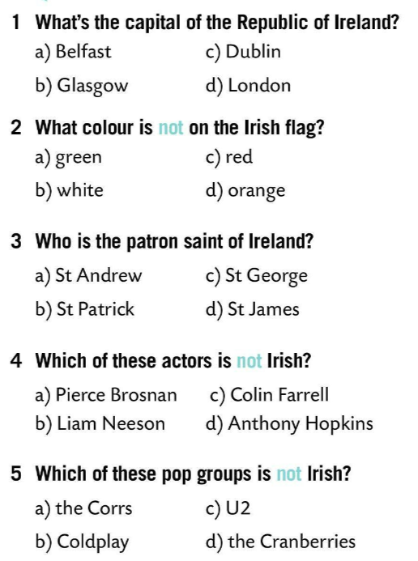
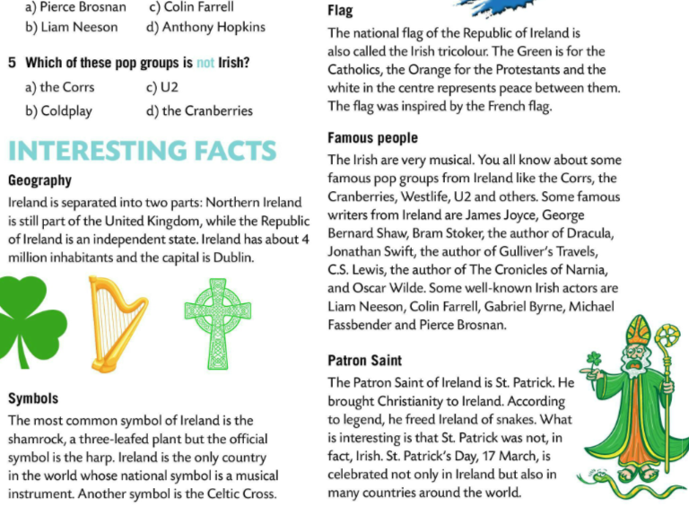
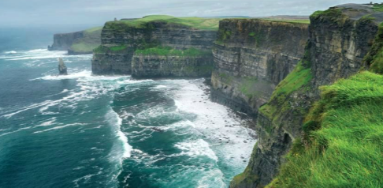
Do the quiz and check your answers in the text.
Read the text.
Let’s check!
Write five sentences about Ireland in your notebook.

Slide 5
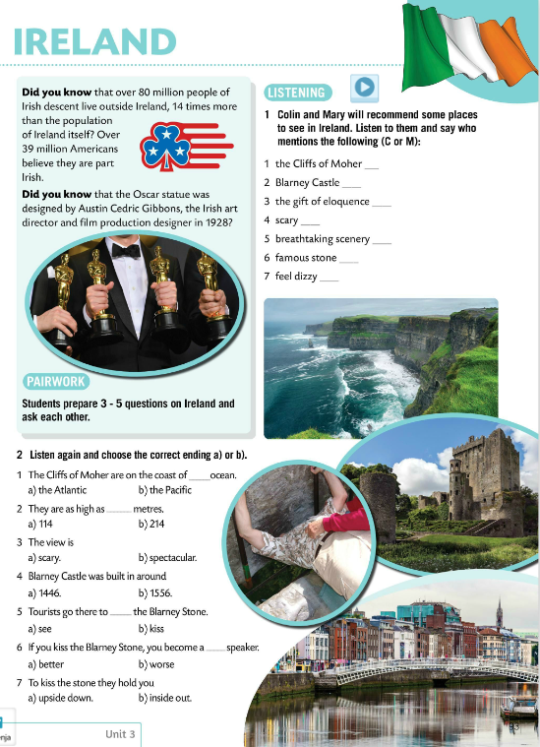
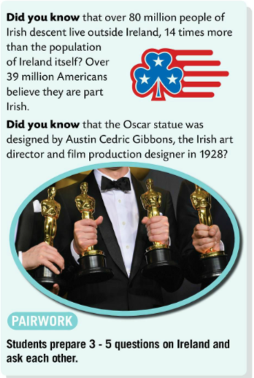
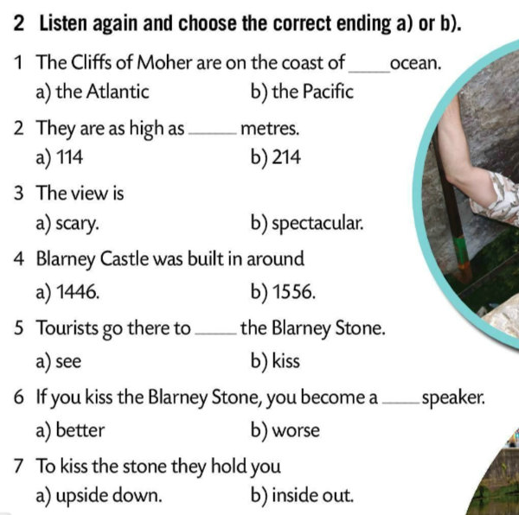
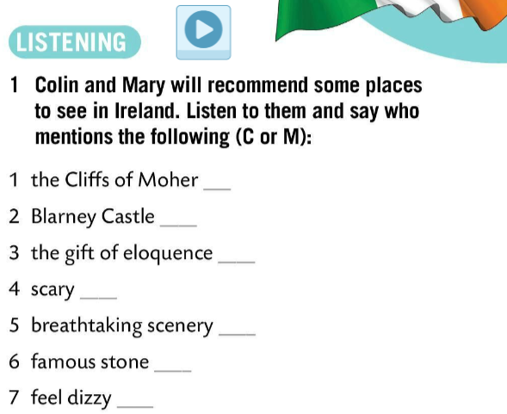

Read the text in pairs and prepare 3 – 5 questions on Ireland. Ask each other these questions.
Colin and Mary will recommend some places to see in Ireland. Listen and say who mentions the following (C or M)?
M
C
C
Check.
C
M
Listen again and complete the sentences.
C
C
Check.

Slide 6
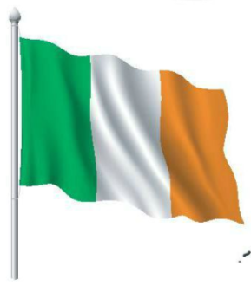
Take a quiz and see how much you know about Ireland. https://wordwall.net/play/849/889/473
Make a poster. Include key details about Ireland. You can add drawings to make the poster more colourful. Enjoy! ☺

